Slide 1

CST63 王天懿

Slide 2
Well actually I'm supposed to have a presentation about boost ,which the other 4 guys left for me.
But unfortunately boost CANNOT behave normally on my computer. I REALLY don't know why.
Since there is already someone who has had a presentation about it, I think I may have some other project as my reading report.
So sorry for that.

Slide 3
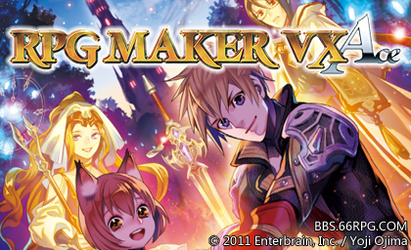
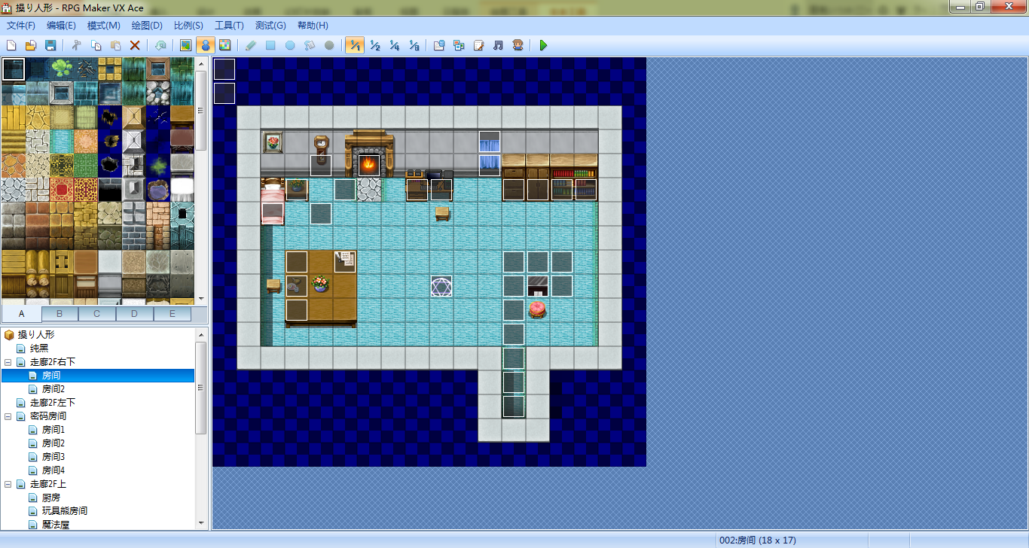
Maybe some of us have already known about it.
A program to make an RPG (Role-playing game), written in programming language ruby.
Users can make an RPG with it easily even without knowing ruby or any other programming language like C++ or Java.
Well ruby is needed if you want to write some advanced functions.

Slide 4
I'm gonna make a simple example to show you how to use it.

Slide 5
So here comes the question...
HOW does it work?

Slide 6
Firstly I'll Introduce something about Ruby.
Ruby is an Object-oriented scripting language, invented by Japanese programmer Yukihiro Matsumoto(松本行弘) in 1995.
Pretty young language.
Complete Object-oriented language that EVERYTHING in ruby is an Object, including classes, methods, integers, even the keyword “class” itself!
Something like python.
Easy for a C++ programmer.
“I thought php was the best prgramming language and then I saw ruby. No objections.”

Slide 7
RGSS3 is an extension library of ruby carried by RMVA.
The RPG game program will be runned with it.
Users can write their own codes based on it.
Now I'm gonna introduce the core parts of RGSS3.

Slide 8
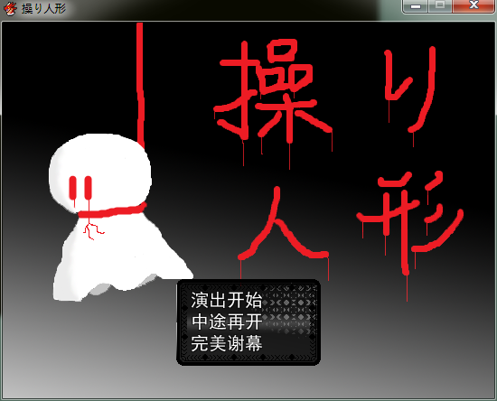
When we enter the game, we have a title scene and we can enter the game, load a savedata or exit the game.

Slide 9
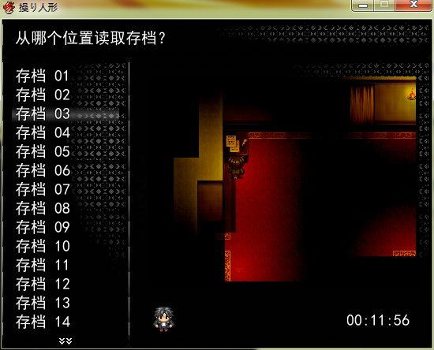
When we load a savedata, we can see where we saved the data and choose a savedata to load

Slide 10
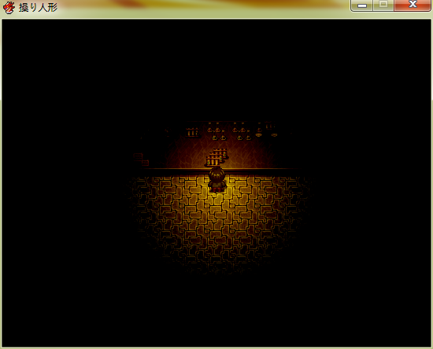
When we entered the game, we can see the map and go around, check an object or open the menu, balabal...

Slide 11
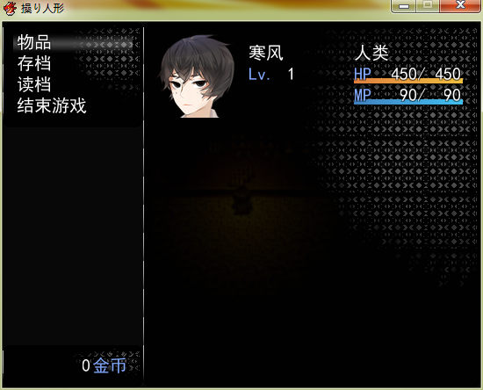
When we opened the menu, we can open the item list, save the data and...
Okay I deleted most of the functions and there are few left.

Slide 12
I seems difficult to actualize such a complex system, let alone let the users write there own codes to actualize some advanced funtions.
In fact, all things to control these procedures are only two:
Scenes(场景) and Windows(窗口).

Slide 13
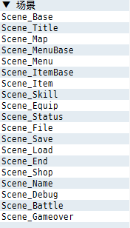
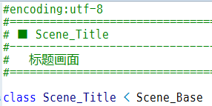
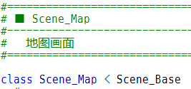
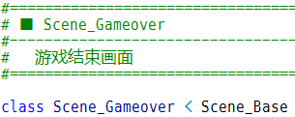
Scene is the classes that represent the scenes.
For example, the title scene is a scene.
The map is also a scene.
Even if you died, you also have a scene to show gameover image.

Slide 14
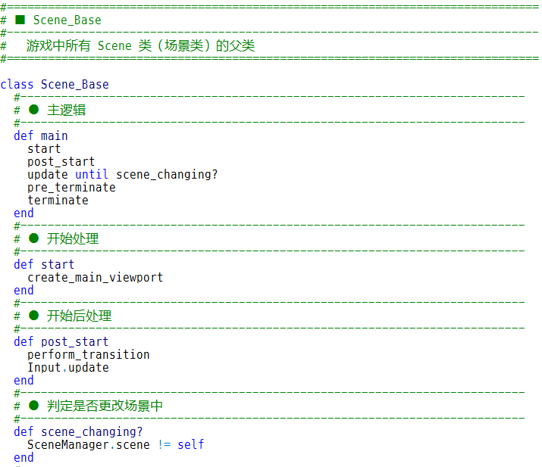
All scene class are the subclass of the base class “Scene_Base”.
All things that a scene may need is written here.
Users can write a subclass and actualize polymorphism(多态) by rewrite a method.

Slide 15
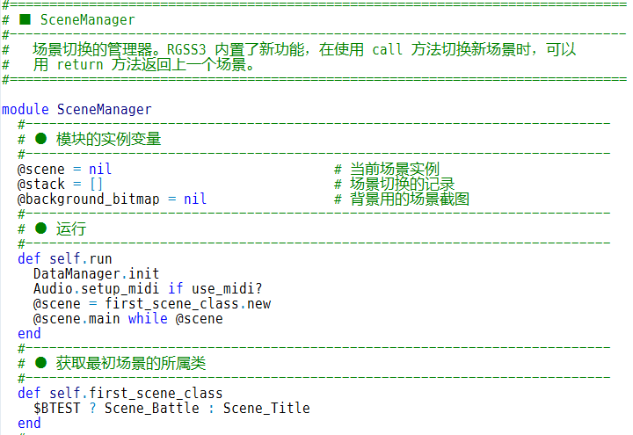
The scenes are managed by a module(namespace) called “SceneManager”.
It actualized a stack to store the instances of the scene classes.
In fact it controls the WHOLE procedure of the program.
The program will exit once the stack is empty.

Slide 16
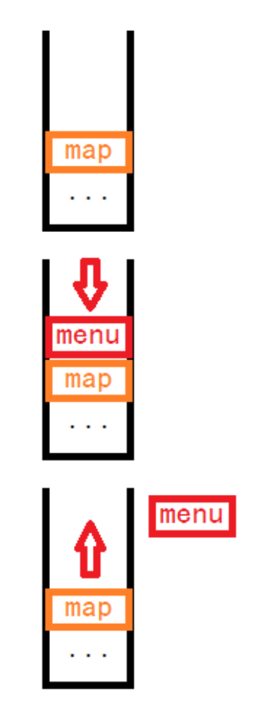
Stack means, when I push a new scene into the stack, the last scene gets frozen.
For example, I'm in the map now, and then I open the menu.
A menu scene is pushed into the stack and I cannot control the map character anymore. The map scene gets frozen.
Then I closed the menu and the menu scene is poped from the stack. now the map scene is the top of the stack and I can control the map character again.

Slide 17
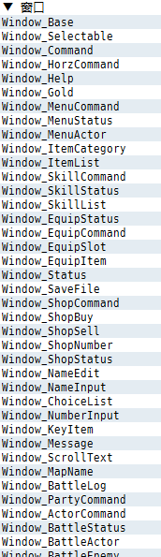
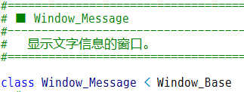
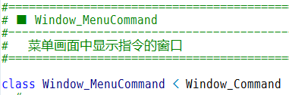
Windows is the class that represents the windows.
A scene has only a background to display and there should be some windows to show the messages like dialogs, menu options and balabala.
We need windows.
Like this.
Like this.

Slide 18
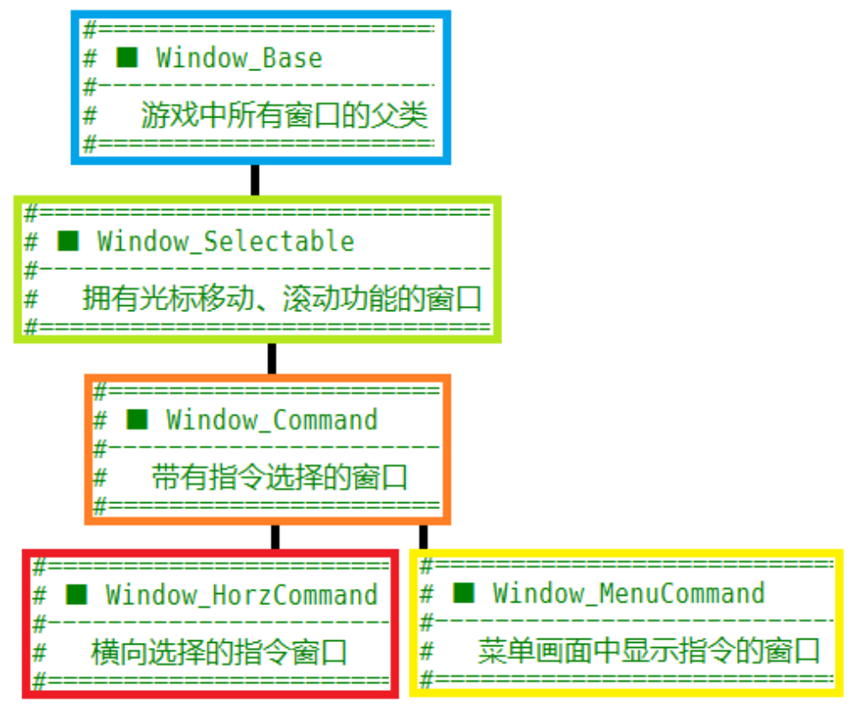
Besides Windows_Base, which is the base class of all window classes, there are other base classes like this:

Slide 19
A scene can have multiple windows.
A window class can have multiple instances.
What are their relations?
answer:
window instances are the MEMBER of a scene instance.

Slide 20
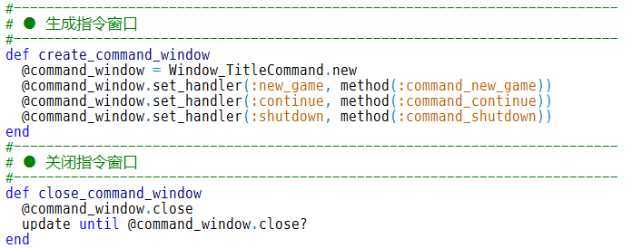
When a scene instance is created, it creates the window instances as its member.
Lets see Scene_Title and Window_TitleCommand as an example.
“method” is like funtion pointer in C++ and “handle” is a hash set.

Slide 21
Initialize the data
The scene manager call main function of current scene
  Initialize the currend scene
  The current scene update itself
    Deal the graphics and inputs.
    Update all the windows
      Deal the graphics and inputs
  Until the current scene is not itself
Until the stack is empty
Exit
That's ALL the program will do.

Slide 22


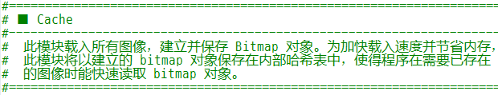
Nothing to explain.

Slide 23


All instances of the data class.
Manager of battles.
Independent from scenes.

Slide 24
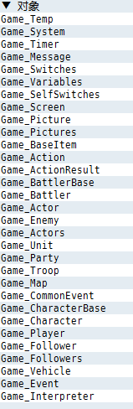
Classes of data and data management

Slide 25
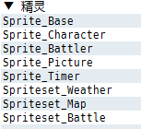
Classes of images.
I don't know why they are called “sprites”.

Slide 26
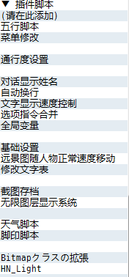
Plug-ins
User can write their own scripts or get them from internet.

Slide 27
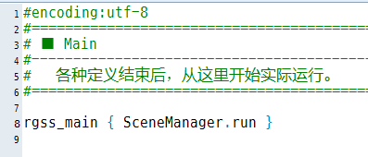
Finally, main function.

Slide 28
Using OOP we can actualize such a complex program, we can regard the flow control as scene management.
Classes instead of Whiles.
In fact in RMVA, events and characters are all regarded as the same thing called Events.
It's also OOP thinking while it is hard for beginners to understand.

Slide 29
Thank you for your attention
Questions are welcomed!

